Slide 1
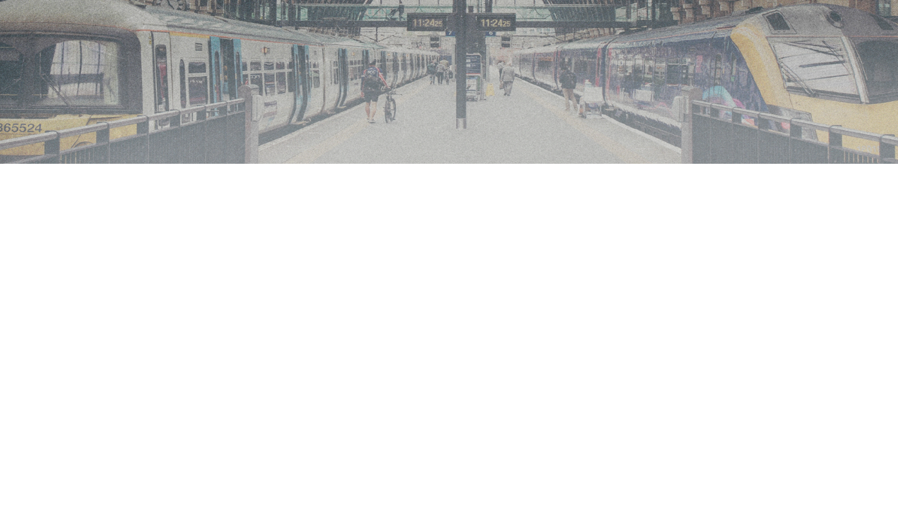

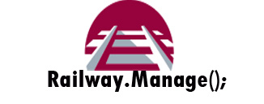
Railway.Manage();
A java application made by the following students
Munnera Alhajri
Rahaf Alzahrani
Reema Alyousef
Tasneem Dosoqi

Slide 2

 | Name | ID | Role Participated in
1 | Muneera Abdullah Alhajri | 2160007230 | Project Manager
2 | Reema Ibrahim Alyousef | 2160003133 | Development Team Leader
3 | Rahaf Saleh Alzahrani | 2160006662 | Head of Research Team
4 | Tasneem Hamdy dosoqi | 2160007430 | Testing Team Leader

Slide 3
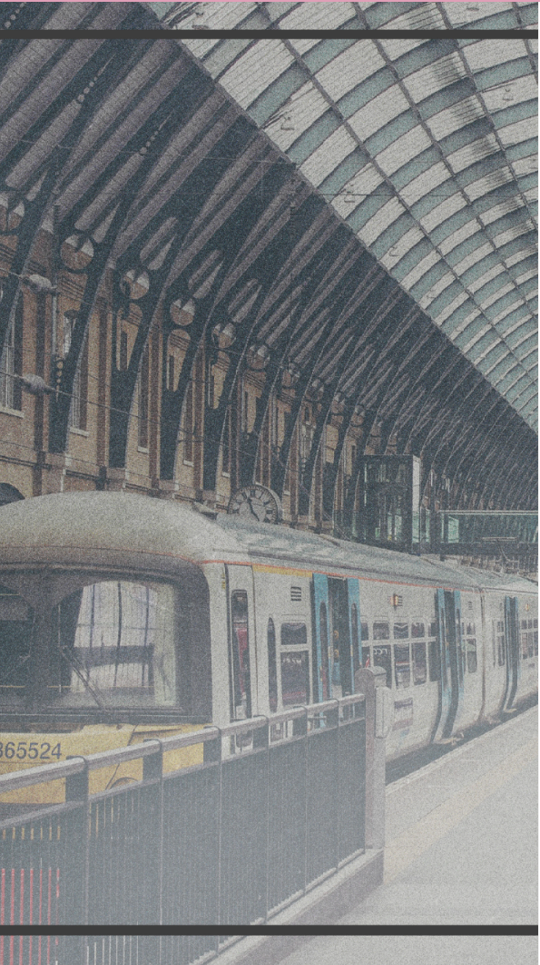
Railway.Manage();
Railway.Manage(); is a system intended to create a digital environment that eases the organization and maintenance of a train station, by way of enabling passengers to access the time table of any station, book a trip or inquire about their ticket information at any time. Additionally, operators are able to edit, delete or add any entry to the timetable through the use of the features offered to them in the system..
The system is designed to operate on multiple stations across the major cities of the country; any passenger of these stations can benefit from the system, whether they use it to purchase a ticket or to merely check the timetable of the station. Furthermore, by utilizing the functions offered to the operators, organizing the station’s workflow can be straightforward and simple.

Slide 4
Problem Statement
As previously mentioned, the aim of this system is to ease the organization of a train station by offering many functionalities that will act as a conduit for passengers to access and control their trips through the comfort of their technological gadgets.
Moreover, operators will be able to access special features that are available to them such as being able to edit, add or delete a trip into the station’s timetable.
Additionally, it will combine all of the features a passenger would need to travel via train into one place that is made easy to navigate and use.

Slide 5
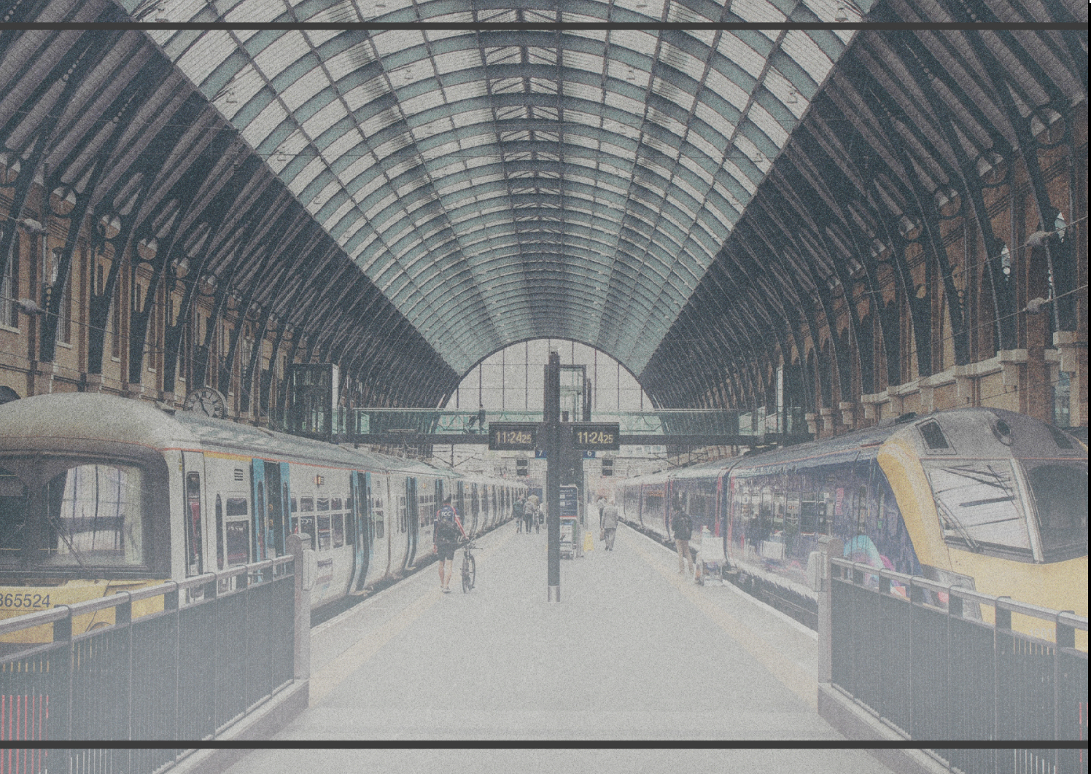
Difficulties & How Problems Were Solved:
Sending the project file between the members was difficult and messy, problems always arose from it.
Communication was difficult, and arranging meetings was tedious.
Writing formal documentation was a new experience for the team, beside it being in the middle of the semester alongside many other assignments, tests…etc
The period of time allocated for each deliverable was too short most of the times, and the milestones were too close to each other.
Creating an imaginary scenario for the project was confusing and messy.
Size and format of the frames in the GUI differed from a member’s computer to another’s.
Data linking refused to work in some members’ devices.
These problems were solved with patience and diligence, and through online search and support from our colleagues.

Slide 6
Lessons Learnt
The team’s skills in technical writing improved a lot during the development of this project.
The team got an insight on how software development is conducted in real life.
Members gained experience for writing code and making an entire new database.
The team got better at scheduling and prioritizing tasks after working on this project.
Dealing with the problems that arose during the project’s development made the members more experienced in dealing with software issues.

Slide 7
Flow of The Application
1.Upon running, the user will be greeted with an introductory frame that contains the different functionalities of the program (each one accessed from a separate button) asking them to make a choice of which one they would like to preform.
2.1:if the user chooses “quick booking” ,another frame will open asking them to enter their various information and will store them in a relation concerned with collecting the passengers’ data.
After that,they get to choose which trip the would like to go on(from a pre-defined list),their seat,class...etc via another frame ,which is the main mean of booking a trip and will generate ticket ID if the booking was made successfully .
2.2:if the user chooses “view ticket”,a frame will open asking them to enter the ticket ID that was generated upon booking,when entered successfully ,the ticket information will be displayed to the user to view.
2.3:The option “Train Schedule”,enables the user to view all the trips available and their timings (departure and arrival) from another frame that will open when the button is selected,thus preforming a query of the relation storing the trips.
2.4:The “operator” button will only be useful to operators that wish to make slight modifications or queries to the existing information stored in the database,whether they are trips,passenger information,tickets...etc,when this button is selected,a frame will open that is capable of preforming such functionalities.
3:note that different exceptions can occur,such as entering an nonexistent ticket ID,invalid inputs or making illegal changes to the database.

Slide 8
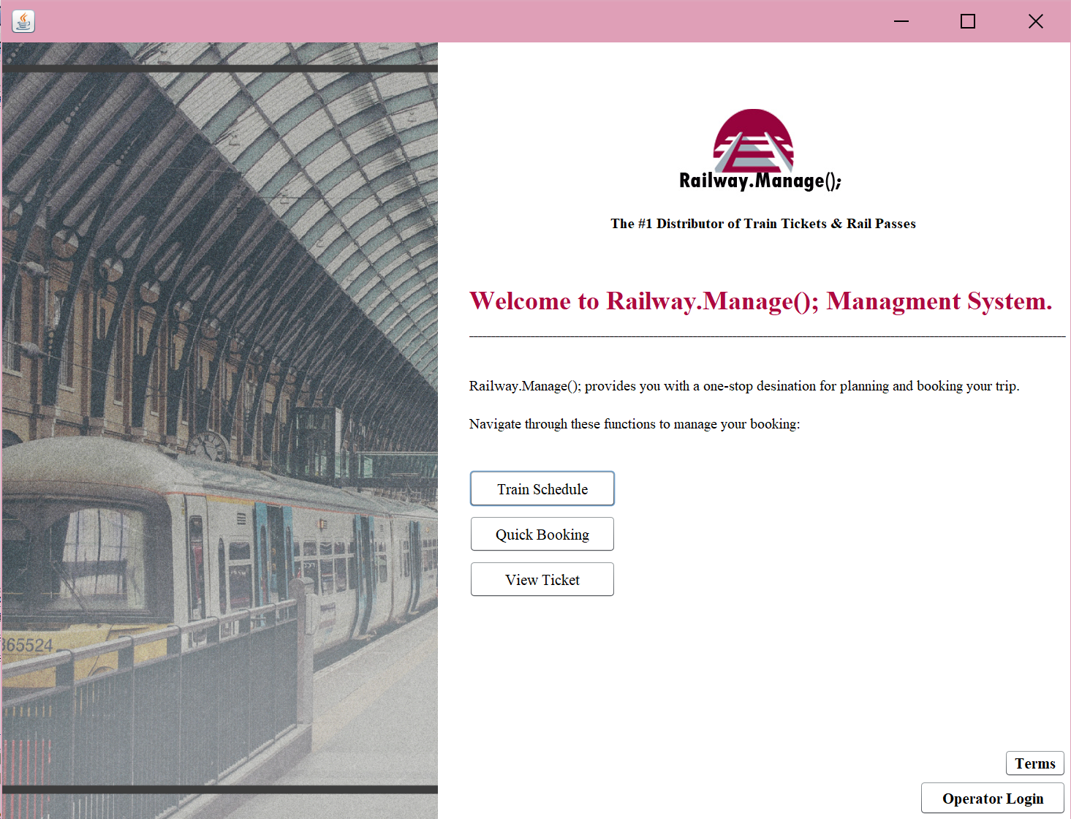

Slide 9
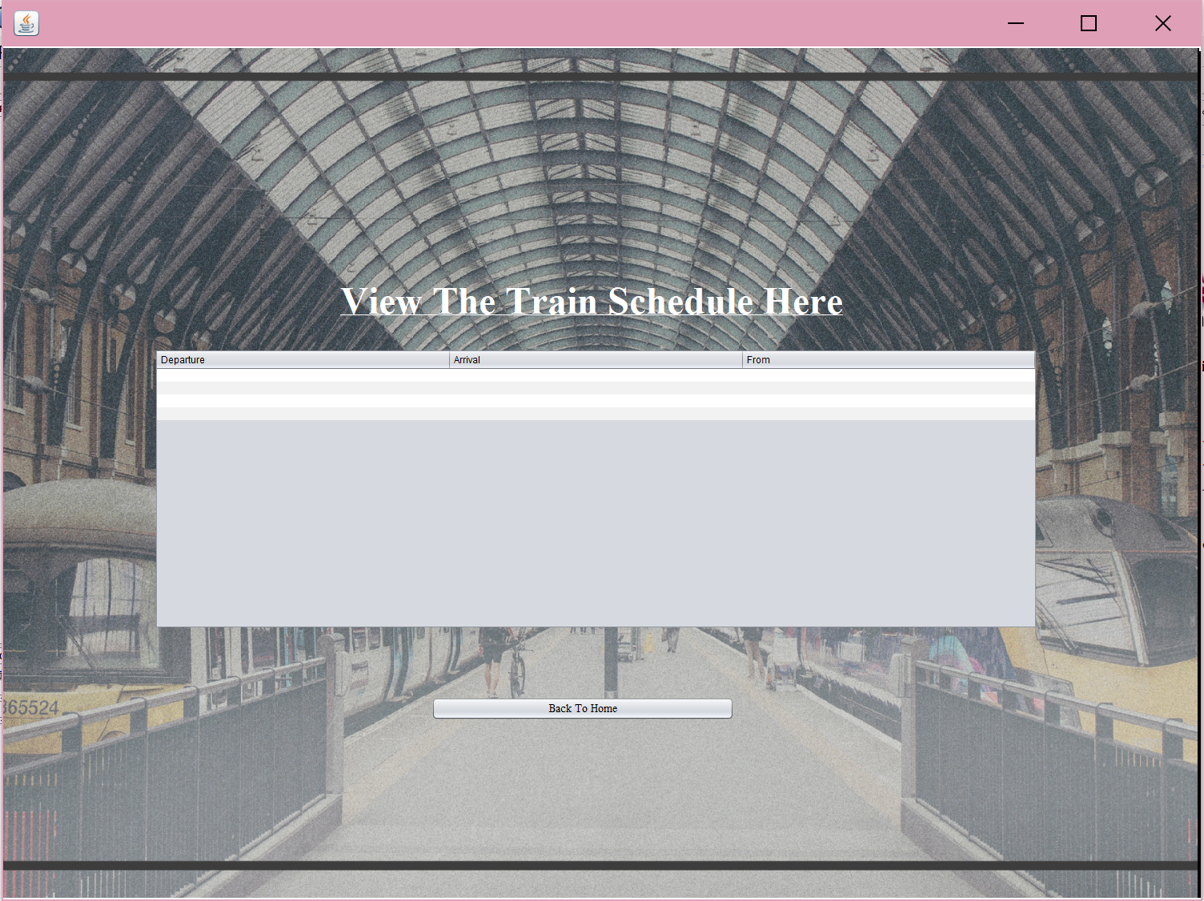

Slide 10
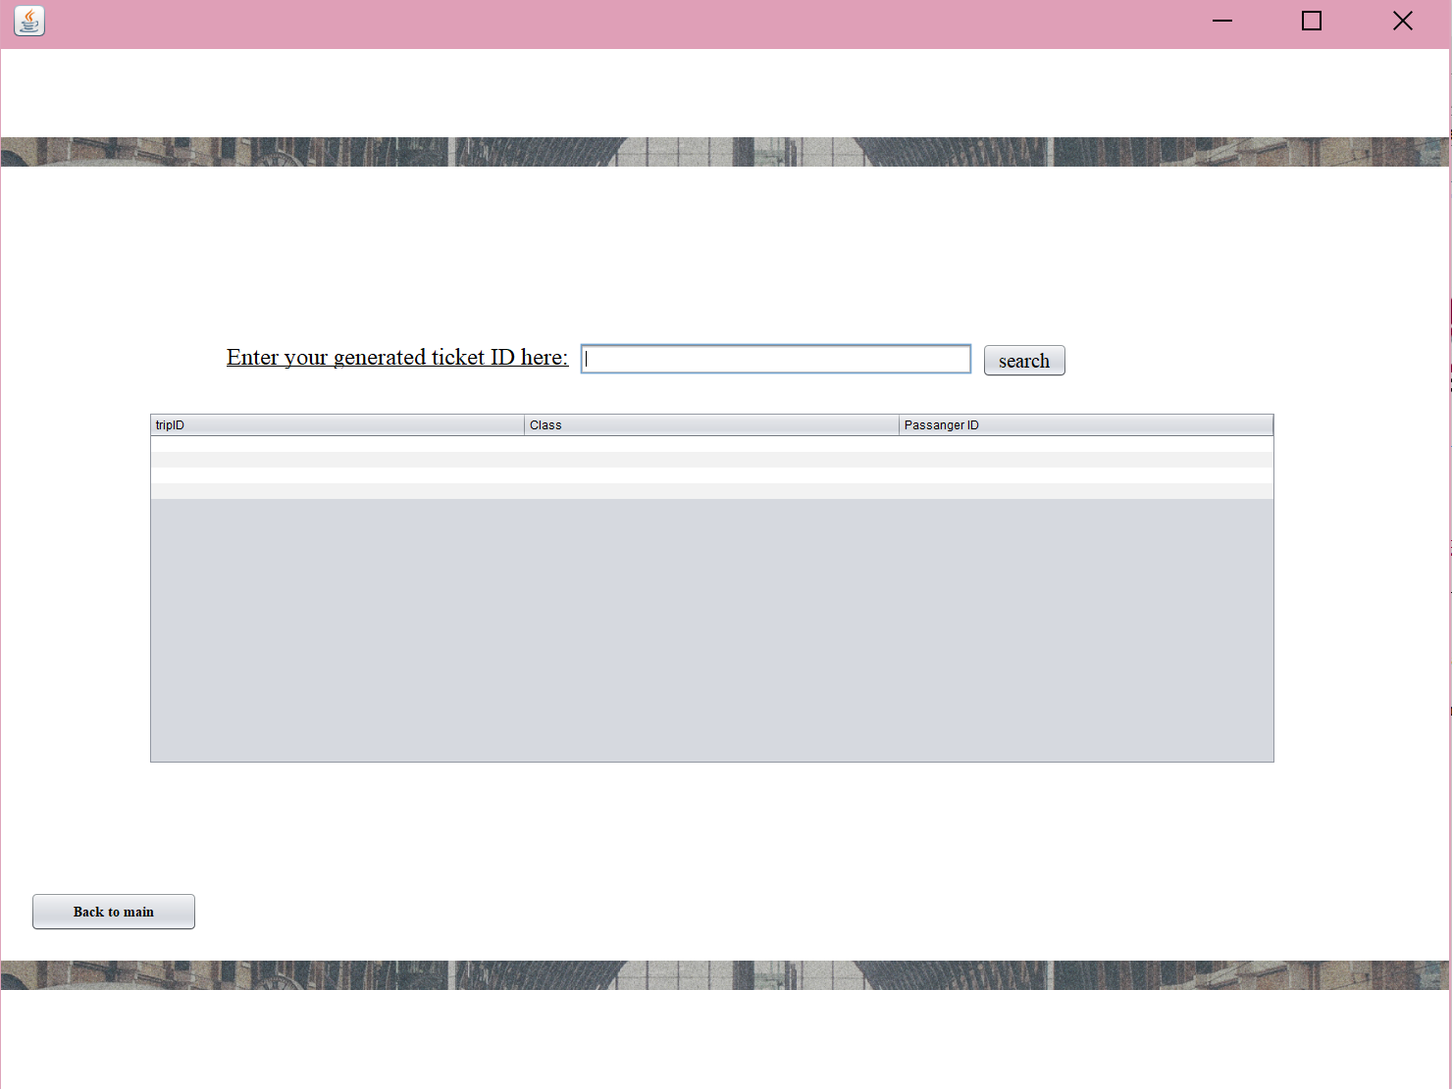

Slide 11
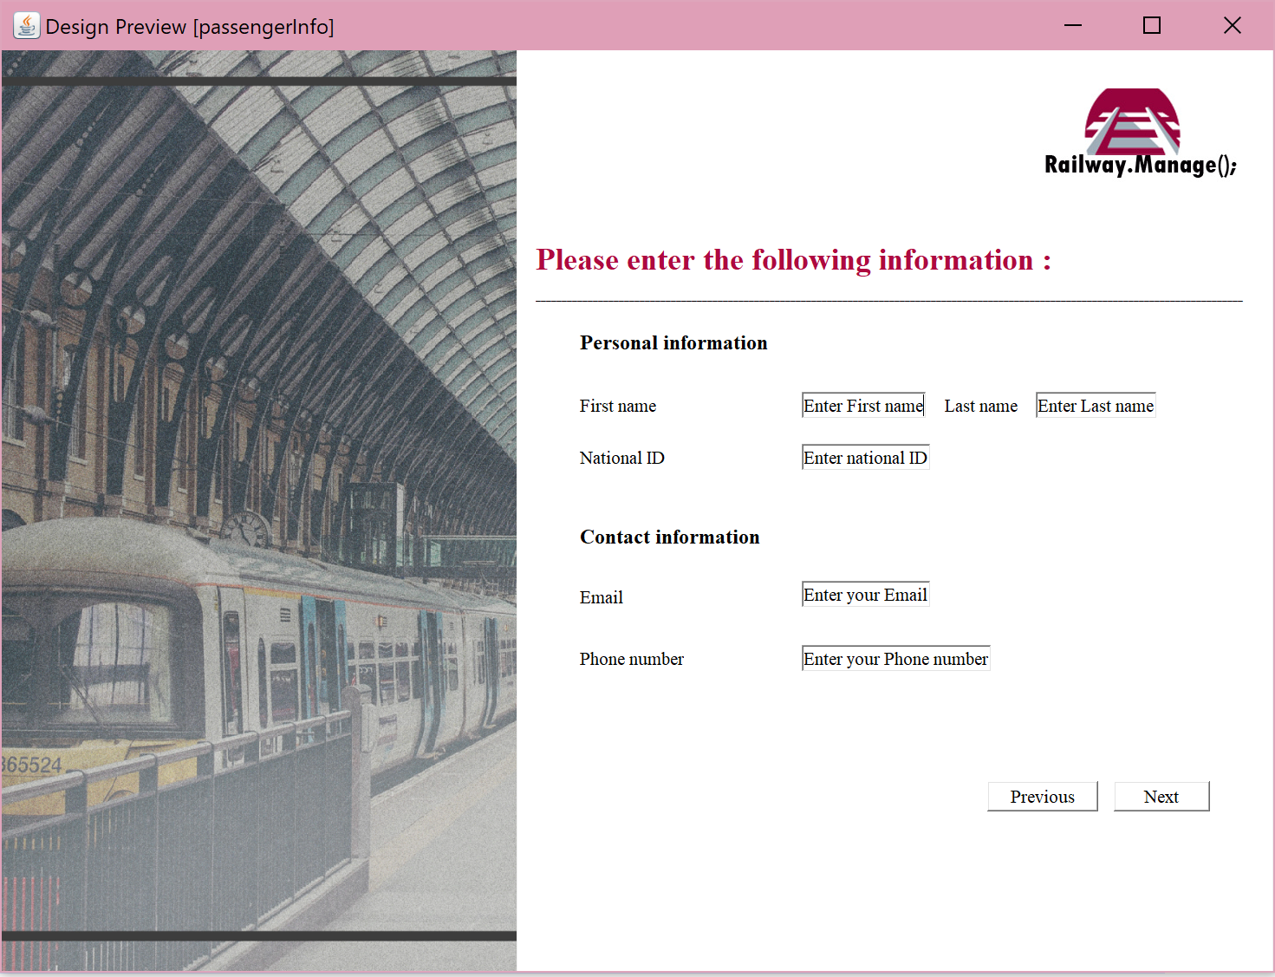

Slide 12
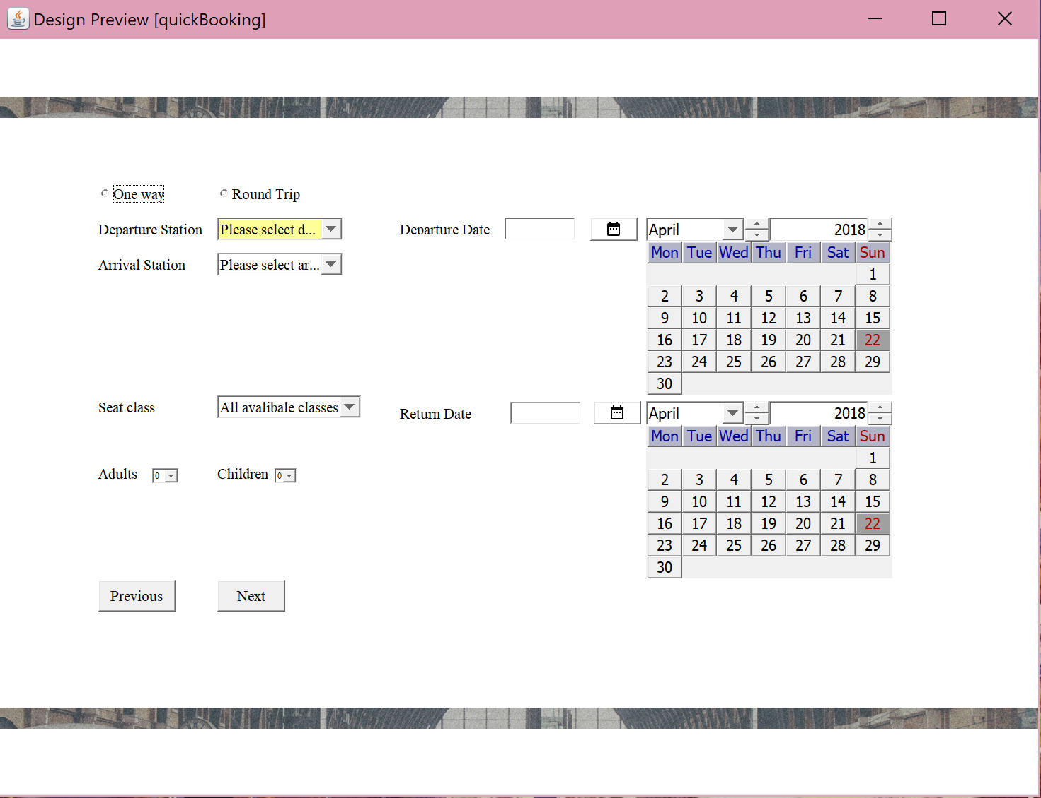

Slide 13
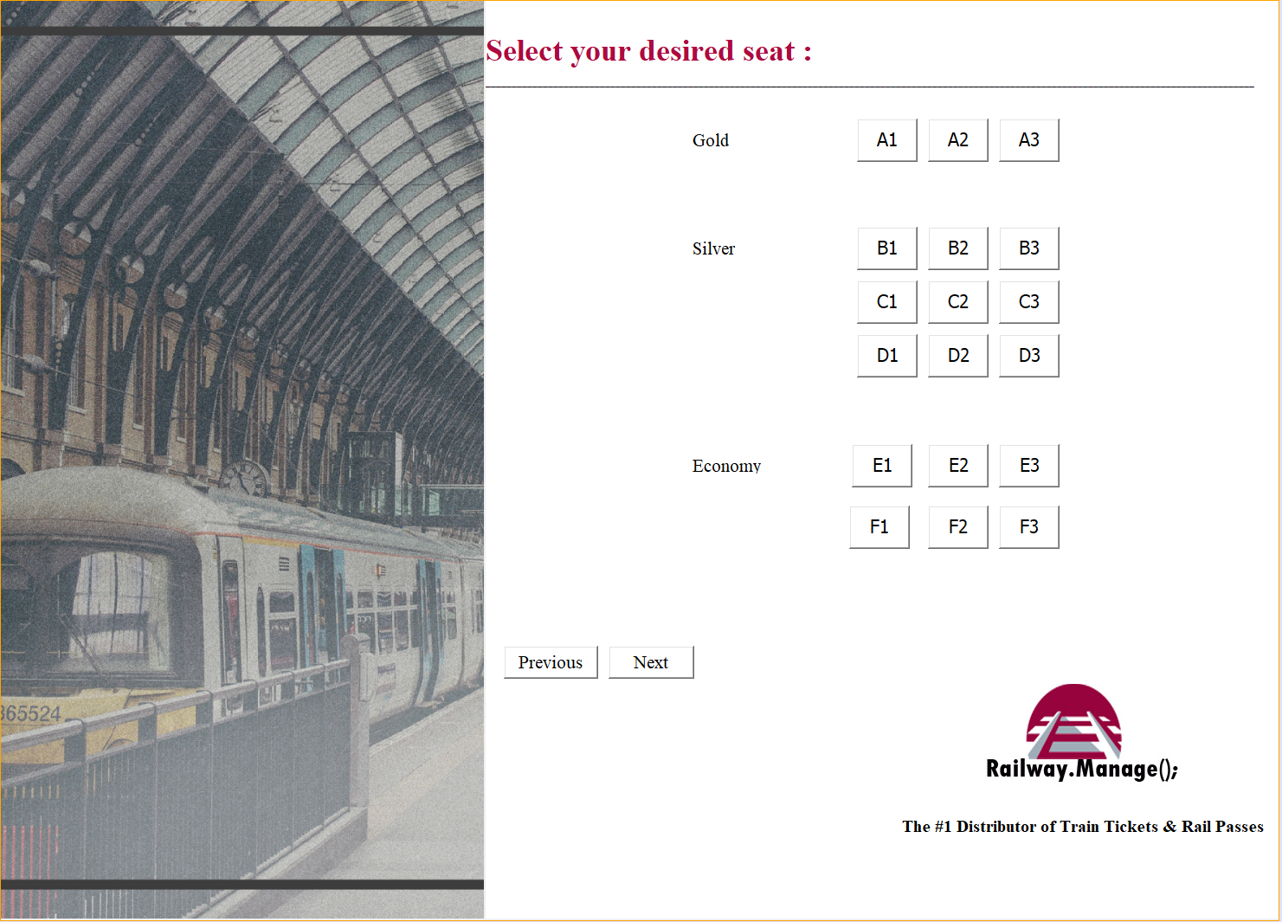

Slide 14
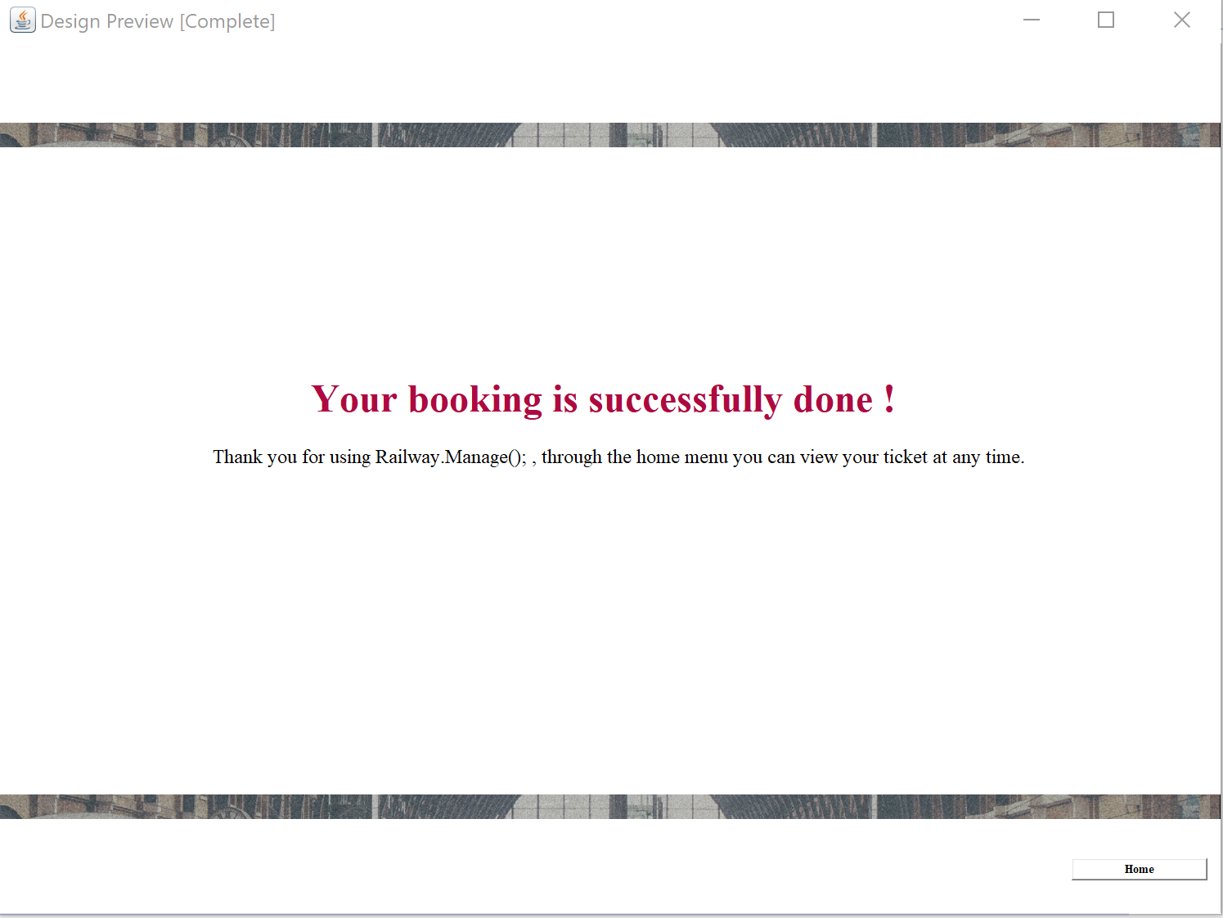

Slide 15
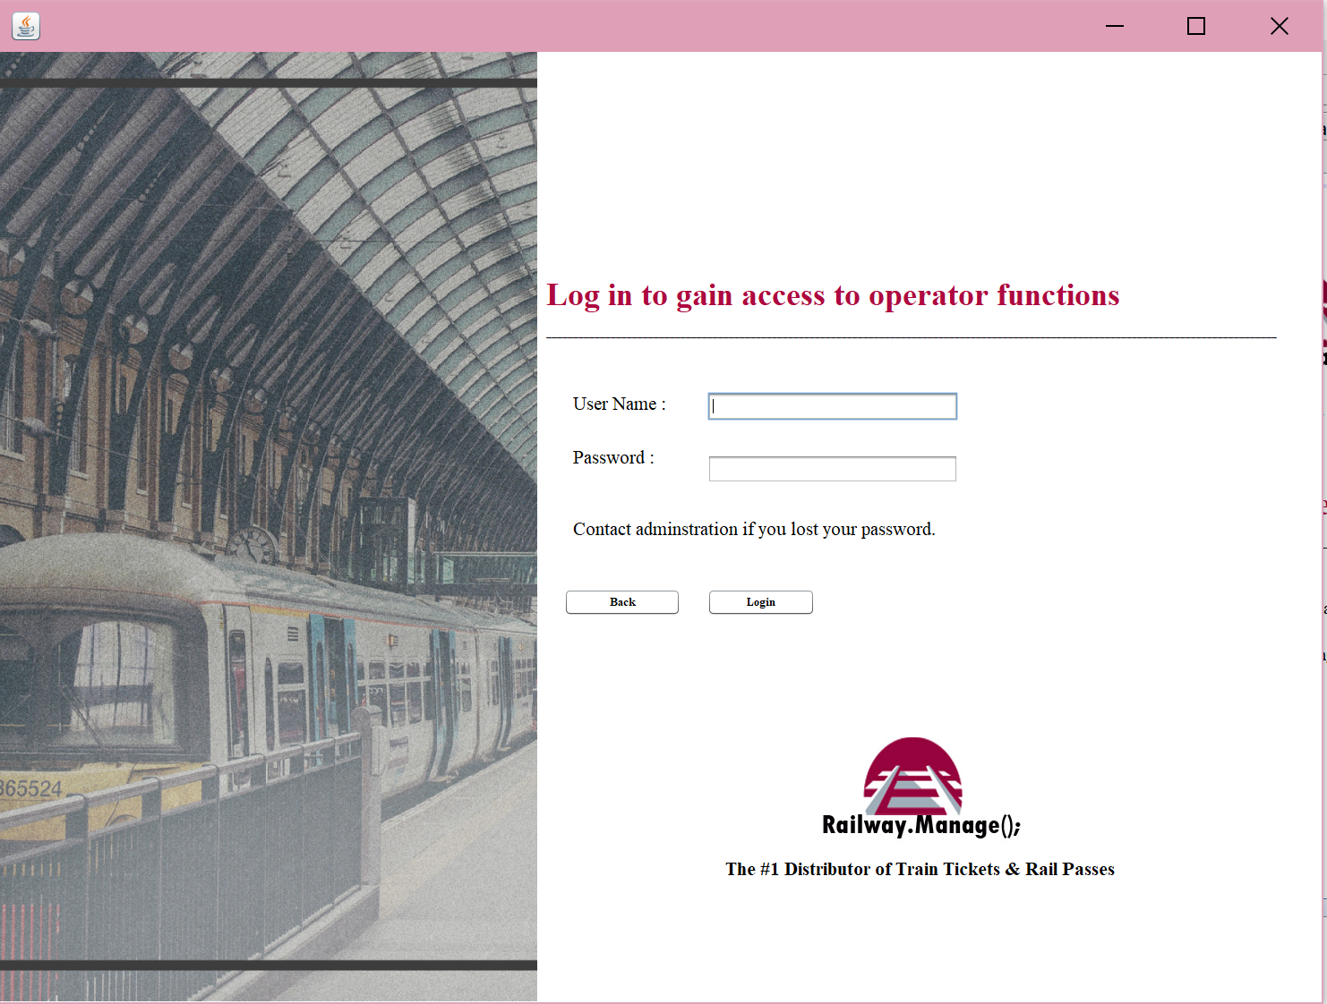

Slide 16
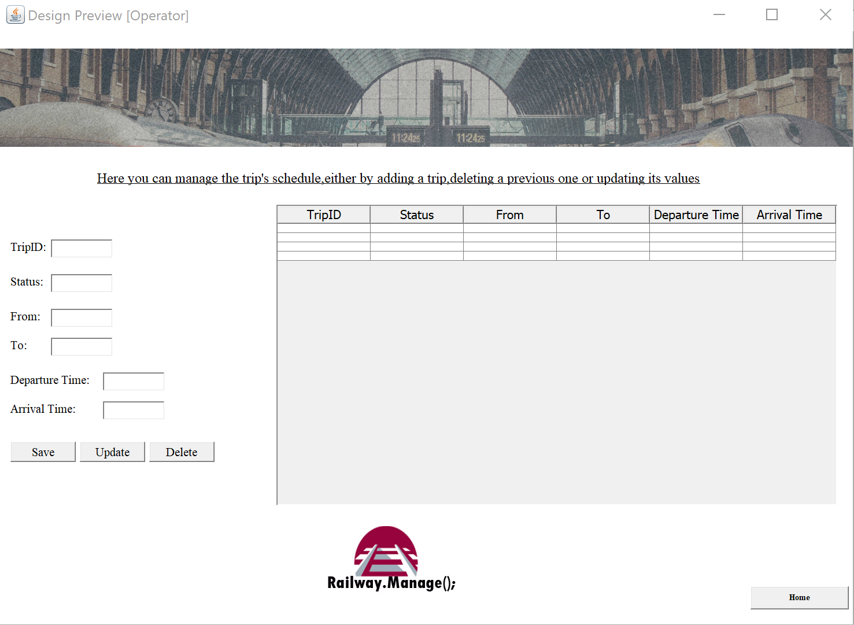

Slide 17
Thanks for listening

